Slide 1




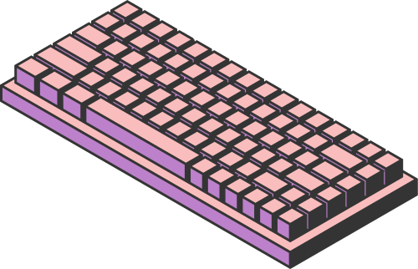
范權榮
HOME
SERVICE
ABOUT US
111210557
PRINCIPLE AND DESIGN
PIPELINE PROCESSOR
111210557 范權榮 | 資訊工程學系二年級
Page 01

Slide 2

范權榮
HOME
SERVICE
ABOUT US
111210557
INTRODUCTION
What is a Pipeline Processor?
A technique used in CPU design to improve instruction throughput.
Instructions are divided into stages, allowing parallel execution.
Why Pipeline Processing?
Enhances performance by overlapping instruction execution.
Maximizes resource utilization in CPUs.
Page 02

Slide 3


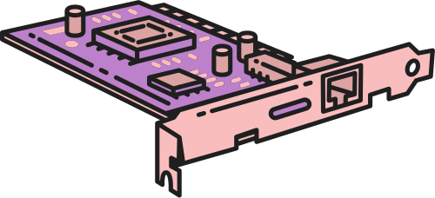
范權榮
HOME
SERVICE
ABOUT US
111210557
KEY CONCEPTS
Pipeline Stages:
Fetch (IF)
Decode (ID)
Execute (EX)
Memory Access (MEM)
Write Back (WB)
Throughput:
Number of instructions completed per unit time.
Latency:
Time taken for a single instruction to pass through all stages.
Page 03

Slide 4


范權榮
HOME
SERVICE
ABOUT US
111210557
CHARACTERISTICS OF PIPELINE STAGES
Each stage in the pipeline handles a specific aspect of instruction execution.
Example stages:
Fetches instructions from memory.
Decodes instructions to understand operations.
Executes operations using ALU or other units.
Accesses memory for data if required.
Writes results back to registers.
Page 04

Slide 5


范權榮
HOME
SERVICE
ABOUT US
111210557
PIPELINE HAZARDS
Definition:
Situations that prevent the next instruction in the pipeline from executing in its designated clock cycle.
Types of Hazards:
Structural Hazards: Resource conflicts.
Data Hazards: Dependencies between instructions.
Control Hazards: Branches and jumps.
Page 05

Slide 6

范權榮
HOME
SERVICE
ABOUT US
111210557
ADVANCED CONCEPTS
Superscalar Pipelines:
Multiple instructions per stage.
Out-of-Order Execution:
Reordering instructions to avoid stalls.
Pipeline Depth:
Balancing depth vs. complexity.
Page 06

Slide 7
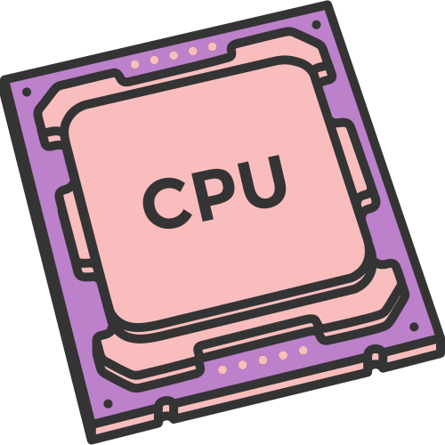
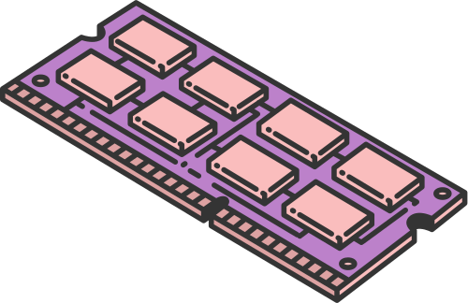
范權榮
HOME
SERVICE
ABOUT US
111210557
REAL-WORLD APPLICATIONS
MODERN CPUS
GPUS
EMBEDDED SYSTEMS
Use highly parallel pipelines for computation.
Optimized pipelines for low power and size.
Intel, AMD, ARM processors.
Page 07

Slide 8
范權榮
HOME
SERVICE
ABOUT US
111210557
CHALLENGES IN PIPELINE DESIGN
Trade-offs:
Complexity vs. performance.
Power Consumption:
Balancing efficiency.
Scalability:
Ensuring performance with more stages or cores.
Page 08

Slide 9



范權榮
HOME
SERVICE
ABOUT US
111210557
CONCLUSION
Summary:
Pipeline processors enhance performance by parallelizing instruction execution.
Design involves balancing speed, efficiency, and complexity.
Future Trends:
AI accelerators and quantum computing may redefine pipelines.
Page 09

Slide 10




范權榮
HOME
SERVICE
ABOUT US
111210557
THANK YOU
Page 10

